Slide 1



Shipment Sure
SHIPMENT SURE
On-Time Shipment Prediction using AI/ML

Slide 2


Shipment Sure
Introduction
In today's fast-paced supply chain industry, timely delivery of shipments plays a vital role in customer satisfaction and brand reliability. However, due to multiple factors such as distance, traffic, weather, and warehouse handling delays, shipments may not always reach on time. With the advancement of Artificial Intelligence and Machine Learning, predictive modeling can now assist in forecasting shipment delays based on historical data. This project leverages machine learning algorithms to predict whether a shipment will arrive on time or not, providing insights for better decision-making and resource planning.

Slide 3
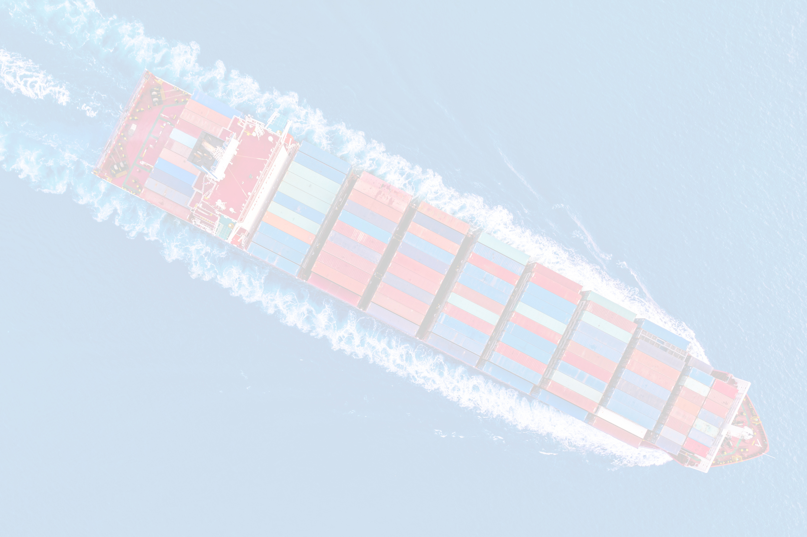

Shipment Sure
Project Pipeline
Dataset Collection
Data Preprocessing
Model Development
Evaluation & Optimization
Model Selection
Model Deployment
EDA

Slide 4



Shipment Sure
Data Collection
Downloaded a Dataset which contains 10,999 shipment records and 12 attributes.
Features:
ID
Warehouse_block
Mode_of_Shipment
Customer_care_calls
Customer_rating
Cost_of_the_Product
Prior_purchases
Product_importance
Gender
Discount_offered
Weight_in_gms
Reached.on.Time_Y.N

Slide 5
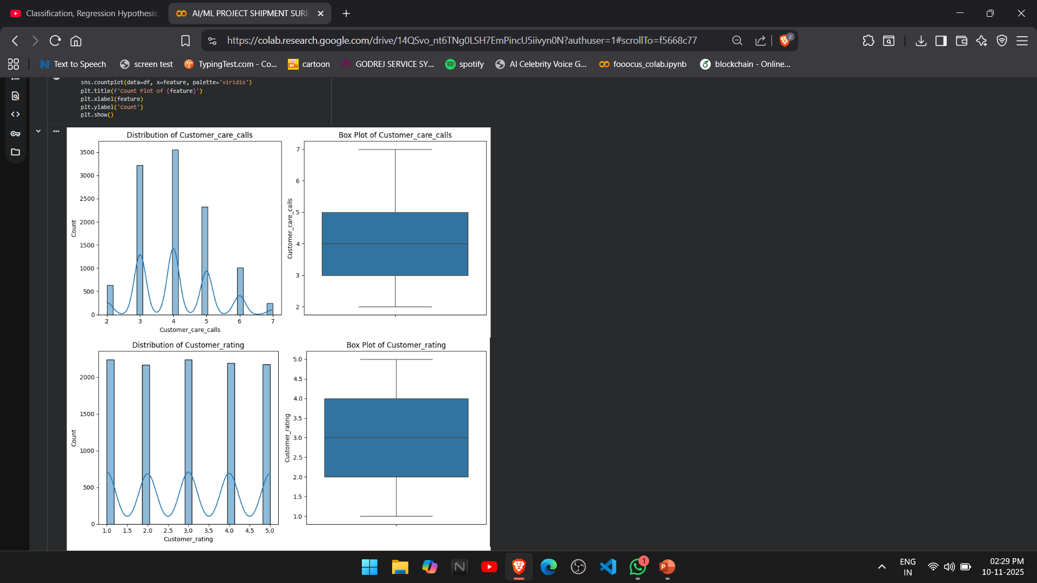
Shipment Sure
EDA
Univariate Analysis
Studied individual feature distributions using histograms and boxplots to identify outliers, skewness, and value ranges.
Network Reach

Slide 6
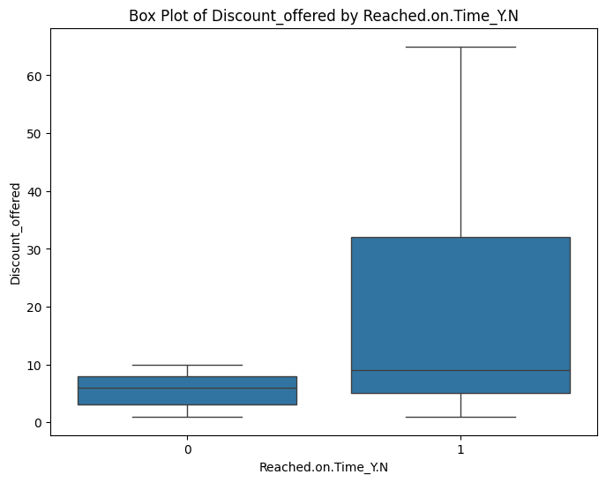
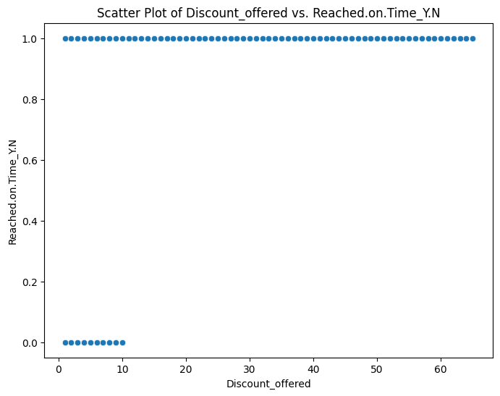
Shipment Sure
EDA
Bivariate Analysis
Explored relationships between independent variables and the target variable (Reached.on.Time_Y.N) using bar plots and scatter plots.
Network Reach

Slide 7
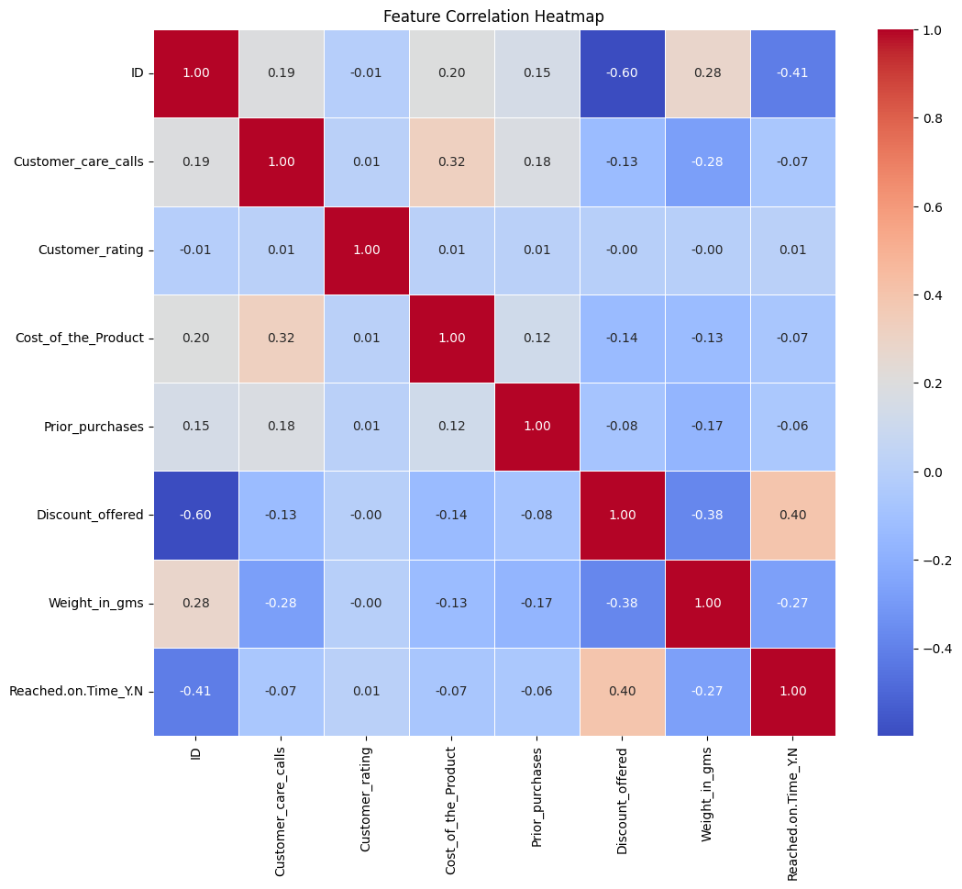
Shipment Sure
EDA
Correlation Analysis
Generated a heatmap to visualize correlations among numerical features and identify multicollinearity.
Pattern & Trend Identification
Observed that shipment factors like Weight, Mode of Shipment, and Cost significantly influence delivery status.
Network Reach

Slide 8
Shipment Sure
Data Preprocessing
Handling Missing Values
Filled missing values using mean imputation for numerical columns (Cost_of_the_Product, Weight_in_gms) and mode imputation for categorical columns (Product_importance).
2.Duplicate & Consistency Checks
Verified dataset integrity by removing duplicate records and ensuring consistent data types across all columns.
3.Encoding Categorical Variables
Converted non-numeric attributes (Warehouse_block, Mode_of_Shipment, Product_importance, Gender) into numeric form using Label Encoding.

Slide 9
Shipment Sure
4.Feature Scaling / Normalization
Standardized numerical features (Cost_of_the_Product, Discount_offered, Weight_in_gms) using StandardScaler to achieve uniform data range.
5.Class Imbalance Handling
Balanced the target variable (Reached.on.Time_Y.N) using oversampling, ensuring equal representation of both “On Time” and “Delayed” classes.
6.Feature Engineering (Part of Preprocessing)
Created a new feature — Cost-to-Weight Ratio, capturing the relationship between product cost and shipment weight for better predictive insights.

Slide 10
Studio Shodwe
Model Development
Model Selection
Implemented multiple machine learning algorithms including Logistic Regression, Random Forest, XGBoost, KNN, Decision Tree, Naïve Bayes, SVM, LightGBM, and CatBoost for classification.
Training and Testing
Trained models using the training dataset (80%) and evaluated performance on the testing and validation sets for reliability.

Slide 11
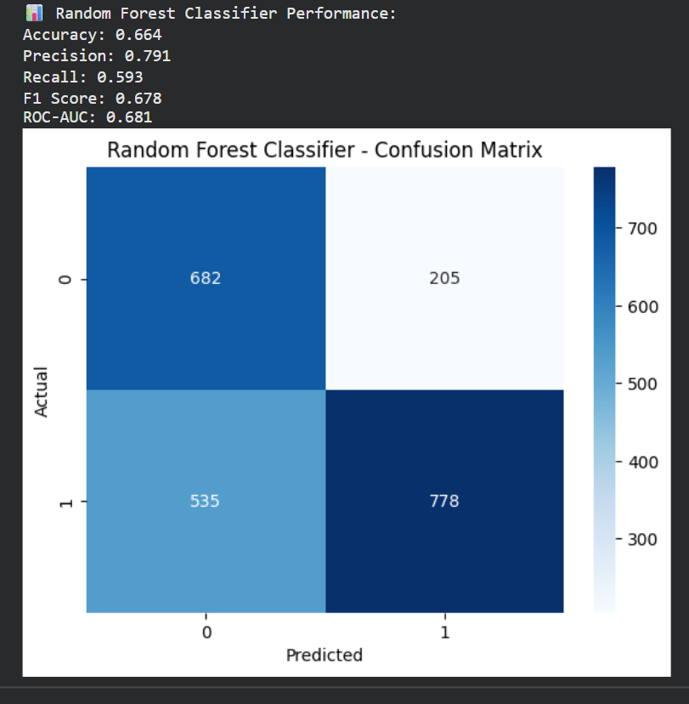
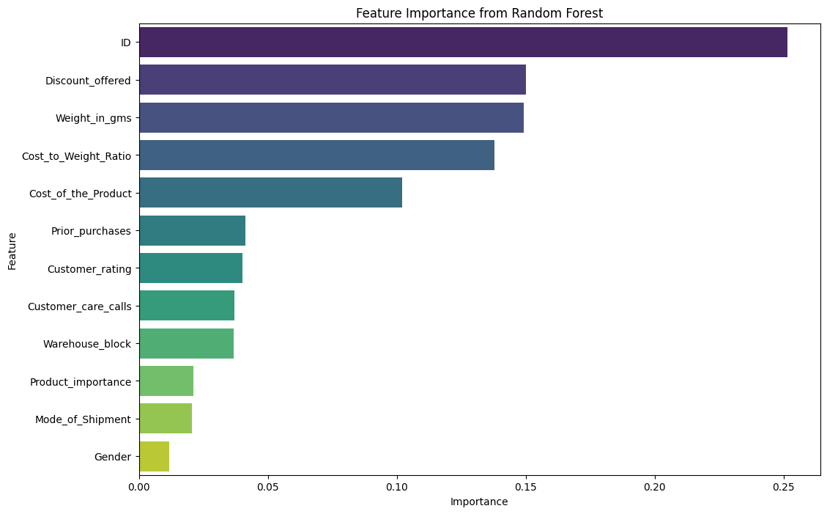
Studio Shodwe
Performance Evaluation
Compared all models using key metrics — Accuracy, Precision, Recall, F1-Score, and ROC-AUC.
Plotted Confusion Matrix and ROC Curves to visualize model effectiveness.

Slide 12
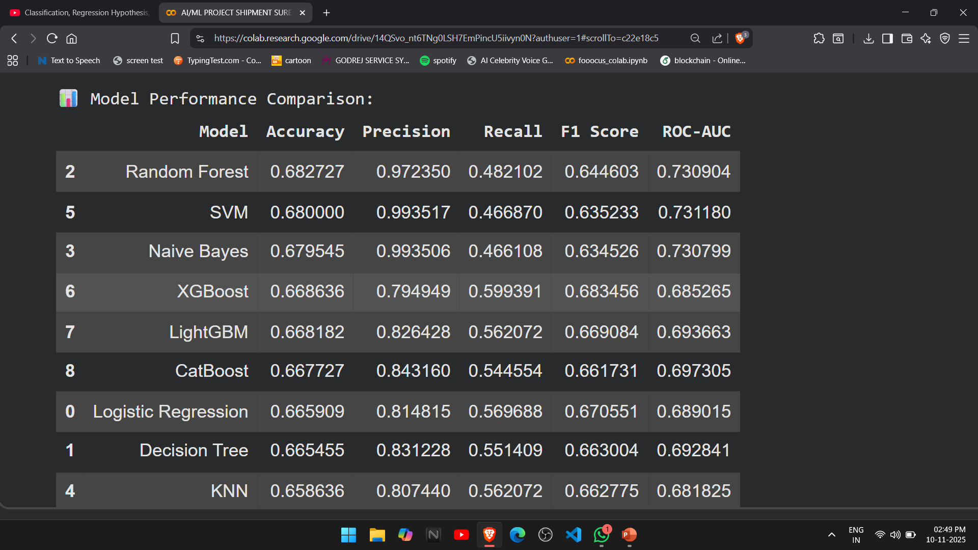
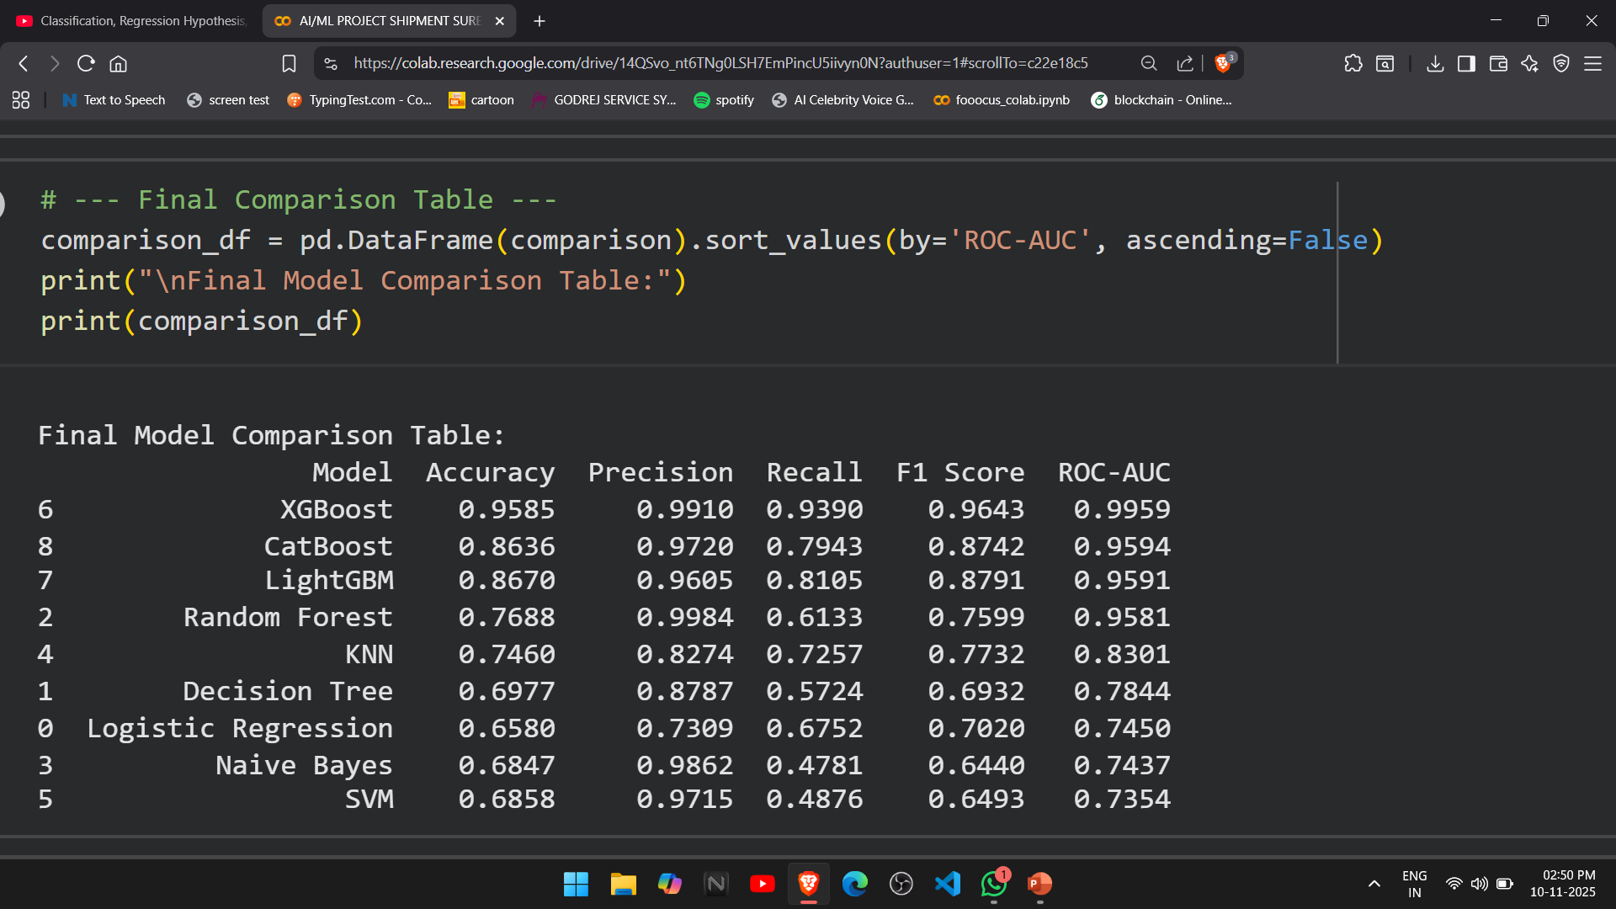
Studio Shodwe
Optimization
Hyperparameter Tuning
Applied GridSearchCV to fine-tune model parameters (especially for Random Forest and XGBoost) to achieve optimal performance.
BEFORE
AFTER

Slide 13
Studio Shodwe
Model Selection and Saving
Identified XGBoost as the best-performing model based on the highest overall accuracy and balanced metrics.
Saved the final trained XGBoost model using Joblib for deployment in the Streamlit application.

Slide 14


Shipment Sure
Model Deployment
Model Integration
Loaded the finalized XGBoost model (saved using Joblib) into a Streamlit application for real-time prediction.
Interface Design
Created a simple, interactive user interface in Streamlit where users can input shipment details such as Cost, Weight, Mode of Shipment, and Discount Offered.
Testing and Validation
Tested the app locally to ensure accurate predictions and smooth functionality.Verified that the results matched offline model performance.

Slide 15
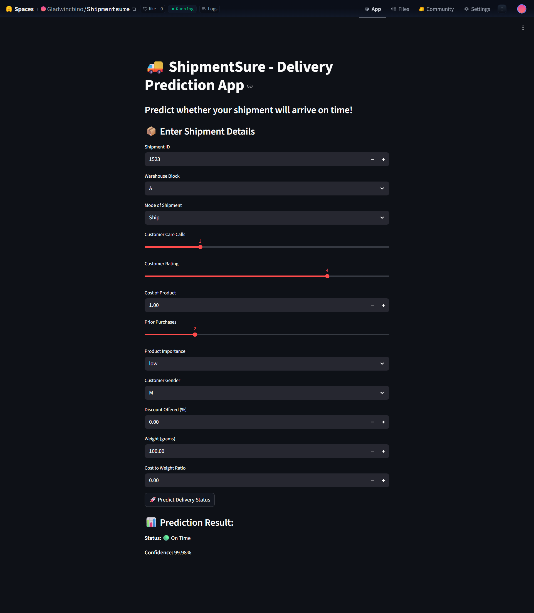
Shipment Sure
Results

Slide 16
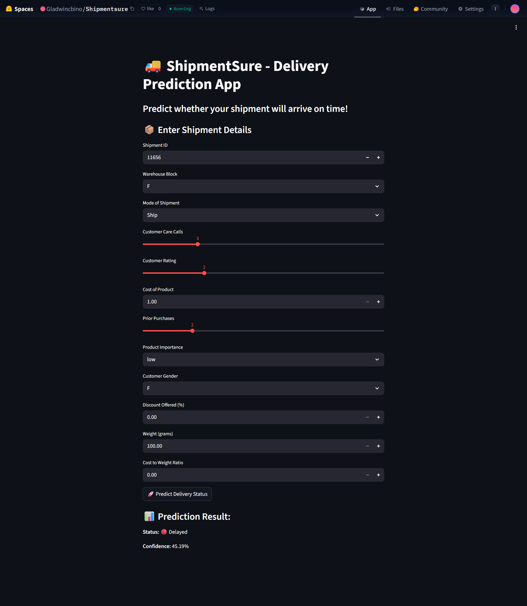
Shipment Sure

Slide 17
Shipment Sure
Final Outcomes
Key Outcomes
Developed a high-performing predictive model (XGBoost) with excellent accuracy and reliability.
Identified key factors affecting shipment delivery time such as Cost_of_the_Product, Weight_in_gms, and Mode_of_Shipment.
Created a complete AI/ML pipeline — including data cleaning, feature engineering, model training, validation, and optimization.
Designed and deployed an interactive Streamlit web application for real-time shipment prediction.
Gained valuable hands-on experience in machine learning, data analysis, and model deployment technologies.
The project “On-Time Shipment Prediction using AI/ML” successfully achieved its objective of building a complete end-to-end machine learning solution capable of predicting whether a shipment will be delivered on time or delayed.
Through systematic implementation of data preprocessing, model development, and deployment, the project delivered both technical accuracy and practical usability.

Slide 18

Shipment Sure
Thank
You!

